Slide 1
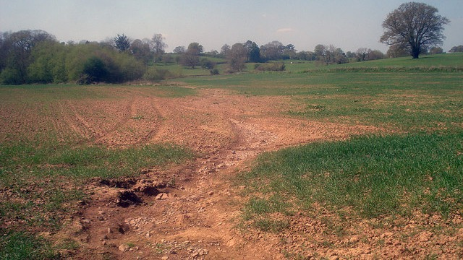
Identifying farmland susceptible to soil erosion
Metis Data Science Bootcamp
Natalie Chen

Slide 2
Soil erosion
Loss of fertile land
Pollution of waterways
Loss of flood control

Slide 3
“33% of the world’s adequate or high-quality food-producing land has been lost at a rate that far outstrips the pace of natural processes to replace diminished soil.”
According to the University of Sheffield’s Grantham Centre for Sustainable Futures (2015):
Image by mariesmolej from Pixabay

Slide 4
Data Source and Features
Soil erosion and organic matter variations for central great plains cropping systems under residue removal R. G. Nelson, J. Tatarko, J. C. Ascough II (2015)
Area symbol
Unique map key
Unique map symbol
Mapunit Name
Acres in mapunit
Percentage of mapunit
Soil loss tolerance factor
Land capability classification for non irrigated/irrigated, broadest/second category
Farmland importance
Water storage capability
Texture description
Texture
Rotation
Yield year 1/2/3
Tillage
Water erosion
Wind erosion
Soil conditioning index(SCI)
SCI field operations
SCI erosion
SCI organic matter
Slope
Residue removal
Average crop residue
Crop for year 1/2/3
Residue removal for year 1/2/3
TARGET: soil erosion
37 features
260K rows

Slide 5
Data Source and Features
Soil erosion and organic matter variations for central great plains cropping systems under residue removal R. G. Nelson, J. Tatarko, J. C. Ascough II (2015)
Area symbol
Unique map key
Unique map symbol
Mapunit Name
Acres in mapunit
Percentage of mapunit
Soil loss tolerance factor
Land capability classification for non irrigated/irrigated, broadest/second category
Farmland importance
Water storage capability
Texture description
Texture
Rotation
Yield year 1/2/3
Tillage
Water erosion
Wind erosion
Soil conditioning index(SCI)
SCI field operations
SCI erosion
SCI organic matter
Slope
Residue removal
Average crop residue
Crop for year 1/2/3
Residue removal for year 1/2/3
TARGET: soil erosion
Features to focus on

Slide 6
Data Source and Features
Soil erosion and organic matter variations for central great plains cropping systems under residue removal R. G. Nelson, J. Tatarko, J. C. Ascough II (2015)
Area symbol
Unique map key
Unique map symbol
Mapunit Name
Acres in mapunit
Percentage of mapunit
Soil loss tolerance factor
Land capability classification for non irrigated/irrigated, broadest/second category
Farmland importance
Water storage capability
Texture description
Texture
Rotation
Yield year 1/2/3
Tillage
Water erosion
Wind erosion
Soil conditioning index(SCI)
SCI field operations
SCI erosion
SCI organic matter
Slope
Residue removal
Average crop residue
Crop for year 1/2/3
Residue removal for year 1/2/3
TARGET: soil erosion
Fewer features the better.
We want farmers to be able to use this model.

Slide 7
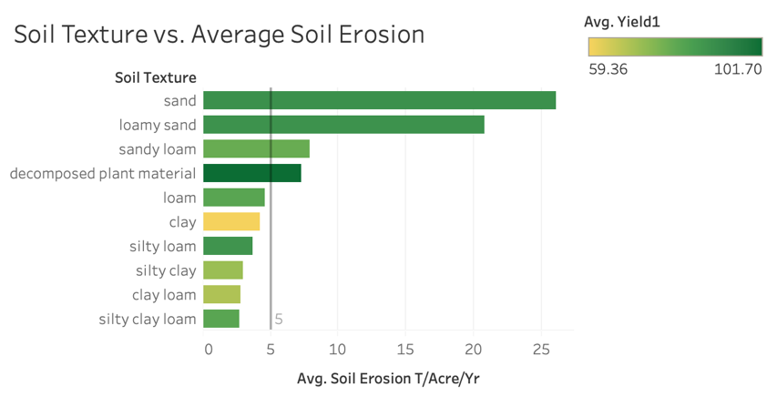
Authors set tolerance level at 5 T/Acre/Yr

Slide 8
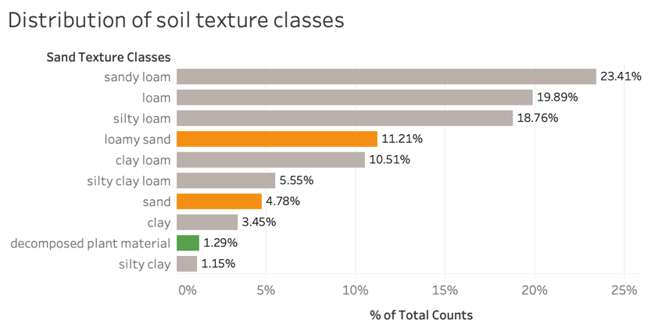

Slide 10
Random Forest Classifier using 6 features
Features (in order of importance)
1. Organic matter
2. Field Operations
3. Slope
4. Crop Rotation
5. Soil Texture
6. Yield
Training score: 0.981
Test score: 0.952
Not tolerated
Precision: 0.93
Recall: 0.92
F1 score: 0.92
Tolerated
Precision: 0.96
Recall: 0.97
F1 score: 0.97

Slide 11
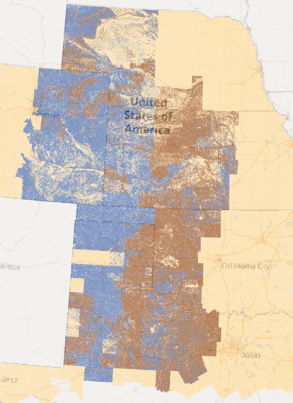
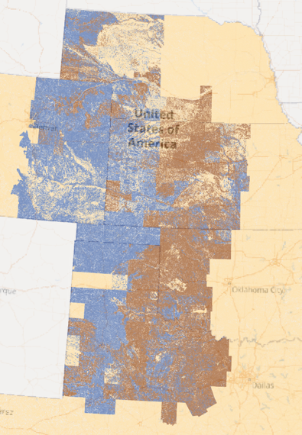
Actual soil erosion
Predicted soil erosion
Legend
Not
tolerated
Tolerated
No information

Slide 12
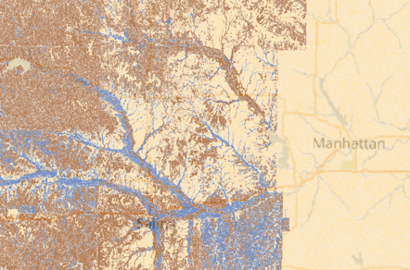
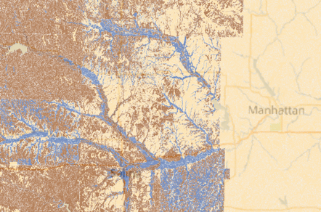
Actual soil erosion
Predicted soil erosion
Legend
Not
tolerated
Tolerated
No information

Slide 13
Next steps
More straightforward measurements of field operations and organic matter – currently part of soil conditioning index
Look at more granular effects of organic material addition
Mapping in python to add map to app
Generate a multiclass model for more precise predictions.

Slide 14
References
Sharkoff, J. Evaluation of Management Alternatives Using the Soil Conditioning Index. https://www.researchgate.net/profile/Anoop_Srivastava7/post/How_the_soil_conditioning_index_SCI_is_calculated/attachment/5aad3d3fb53d2f0bba589d3f/AS%3A605202155577345%401521302846910/download/Montrose_SCI_120207+compressed.pdf
Tatarko, John; Ascough II, James C.; Nelson, Richard. (2015). Soil erosion and organic matter for central Great Plains cropping systems under residue removal. Ag Data Commons. https://doi.org/10.15482/USDA.ADC/1167058.
Milman, O. (2015, December 02). Earth has lost a third of arable land in past 40 years, scientists say. Retrieved October 28, 2020, from https://www.theguardian.com/environment/2015/dec/02/arable-land-soil-food-security-shortage

